Slide 1

Final Engagement
Attack, Defense & Analysis of a Vulnerable Network
Report Prepared by:
Jared Alanis, Marlen Bovadilla, Jhon Castrillon, Benny Mosley, Kevin Omana & Ashlen Perez
Notes:
Benny Mosley

Slide 2
Table of Contents
This document contains the following resources:
Network Topology & Critical Vulnerabilities
Traffic Profile
Normal Activity
Malicious Activity
Notes:
Benny Mosley

Slide 3

Network Topology
‹#›
Notes:
Benny Mosley

Slide 4
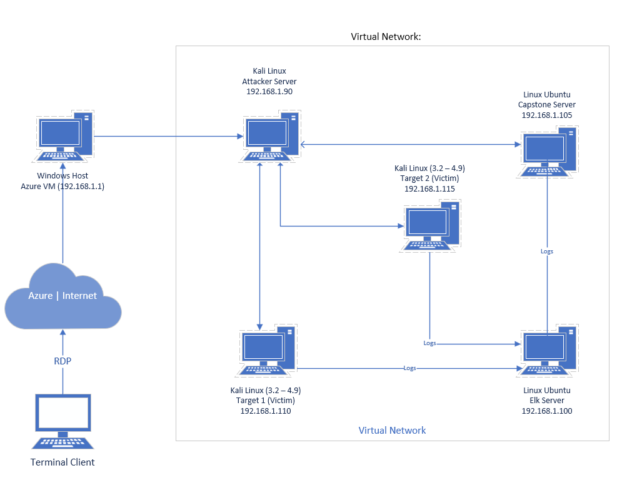
Network Topology
[Insert Here]
Use draw.io to create a diagram of the network.
Add your diagram to this slide and fill out the data in the sidebar.
Network
Address Range: 192.168.1.0/24
Netmask: 255.255.255.0
Gateway: 192.168.1.1
Machines
IPv4: 192.168.1.90
OS: Linux
Hostname: Kali
IPv4: 192.168.1.100
OS: Linux
Hostname: ELK
IPv4: 192.168.1.105
OS: Linux
Hostname: Capstone
IPv4: 192.168.1.110
OS: Linux
Hostname: Target 1
Notes:
Benny Mosley

Slide 5

Critical Vulnerabilities
‹#›
Notes:
Benny Mosley

Slide 6
Critical Vulnerabilities: Target 1
Our assessment uncovered the following critical vulnerabilities in Target 1.
Vulnerability | Description | Impact
Wordpress Brute Enumeration CVE-2009-2336 CVE-2009-2335 | It allows attackers to enumerate User Names (Command: wpscan --url http://192.168.1.110/wordpress --wp-content-dir -ep -et -eu) | Allows for a brute force attack on a single username
Weak Password | One of the users: Michael had his password set also as Michael | Easy access to user files
Privilege Escalation with Python | Using a single line of code escalates user privilege to root | Gives root privileges to user
mysql login credentials stored on public server file | wp-config.php contains login and password for mysql database | exposed hash values for 2 users
Notes:
Marlen Bovadilla

Slide 7
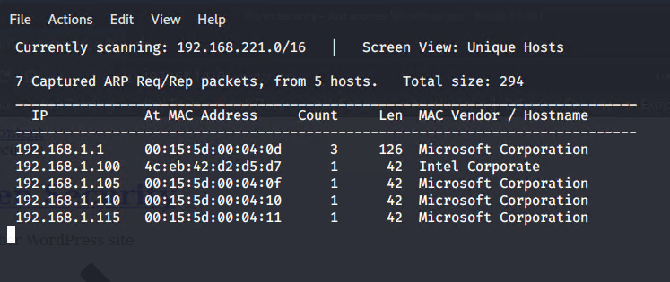
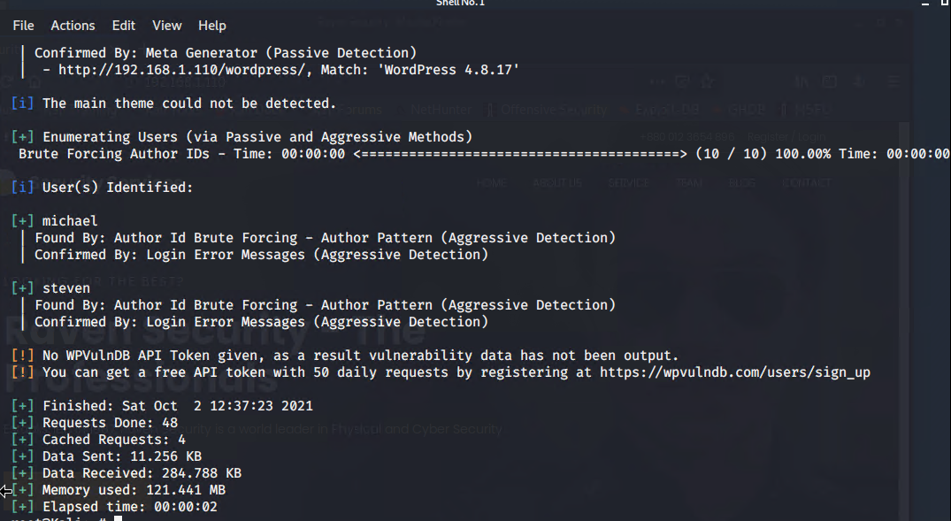
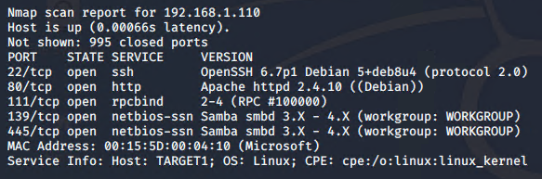
Target 1 Scanning Details
Scanned the network to identify the IP address of Target 1
(Command:netdiscover)
Scanned Target 1 IP address for vulnerabilities and OS (Command:
nmap -sV 192.168.1.110)
Enumerated WordPress site and obtained user names (Command: wpscan --url http://192.168.1.110/wordpress --wp-content-dir -ep -et -eu)
Notes:
Benny Mosley

Slide 8

Traffic Profile
‹#›
Notes:
Benny Mosley

Slide 9
Traffic Profile
Our analysis identified the following characteristics of the traffic on the network:
Feature | Value | Description
Top Talkers (IP Addresses) | 172.16.4.205 (49.36%) 185.243.115.84 (29.16%) 10.0.0.201 (18.74%) 166.62.111.64 (15.11%) | Machines that sent the most traffic.
Most Common Protocols | TPC (88.7%) UDP (11.24%) None (.09%) | Three most common protocols on the network.
# of Unique IP Addresses | 808 | Count of observed IP addresses.
Subnets | 10.0.0.0/24 10.6.12.0/24 172.16.4.0/24 192.168.1.1/24 | Observed subnet ranges.
# of Malware Species | june11.dll | Number of malware binaries identified in traffic.
Notes:
John Castrillon

Slide 10
Behavioral Analysis
Purpose of Traffic on the Network
Users were observed engaging in the following kinds of activity.
“Normal” Activity
Browsing blog sites.
Watching youtube
Working on Wordpress sites.
Suspicious Activity
Downloading from publicdomaintorrents.info.
Visiting www.iphonehacks.com
Visiting torrent.ubuntu.com:6969
Notes:
Jhon Castrillon

Slide 11

Normal Activity
‹#›
Notes:
Benny Mosley

Slide 12
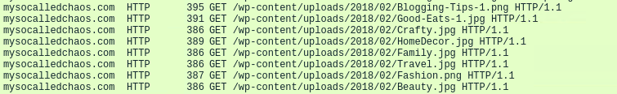
Web Surfing
Summarize the following:
What kind of traffic did you observe? Which protocol(s)?
The traffic observed was HTTP protocol.
What, specifically, was the user doing? Which site were they browsing? Etc.
The user was browsing a blogging website called mysocalledchaos.com. They clicked through links such as “Read the Blog”, “About”, “Better Your Blog”, “Good Eats”, “Travel”, etc.
Notes:
Jared Alanis

Slide 13
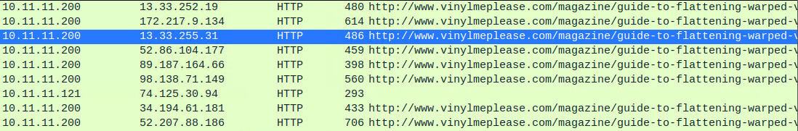
Visiting websites
Summarize the following:
What kind of traffic did you observe? Which protocol(s)?
HTTP web traffic
What, specifically, was the user doing? Which site were they browsing? Etc.
User browsed http://www.vinylmeplease.com/magazine/guide-to-flattening-warped-vinyl-records/
Notes:
Jared Alanis

Slide 14

Malicious Activity
‹#›
Notes:
Benny Mosley

Slide 15
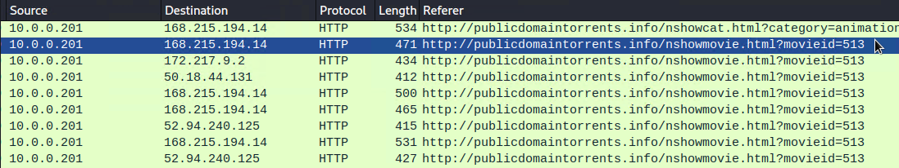
Malicious Activity 1: publicdomaintorrents.info
Summarize the following:
What kind of traffic did you observe? Which protocol(s)?
HTTP web traffic
What, specifically, was the user doing? Which site were they browsing? Etc.
User was trying to download a movie on publicdomaintorrents.info
NOTE: Torrent websites could be filled with malicious files disguised as legitimate
Notes:
Kevin Omana

Slide 16
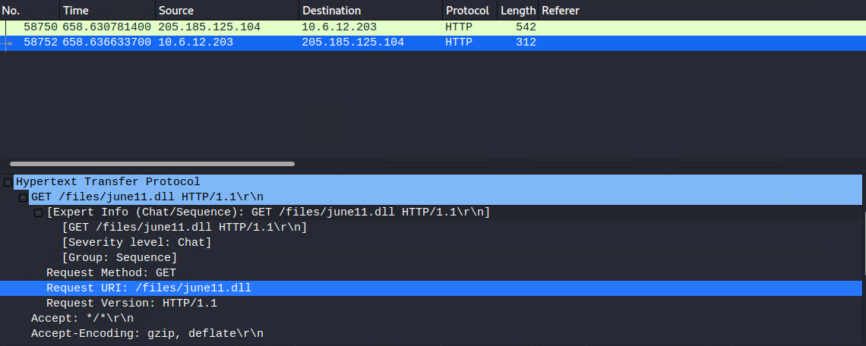
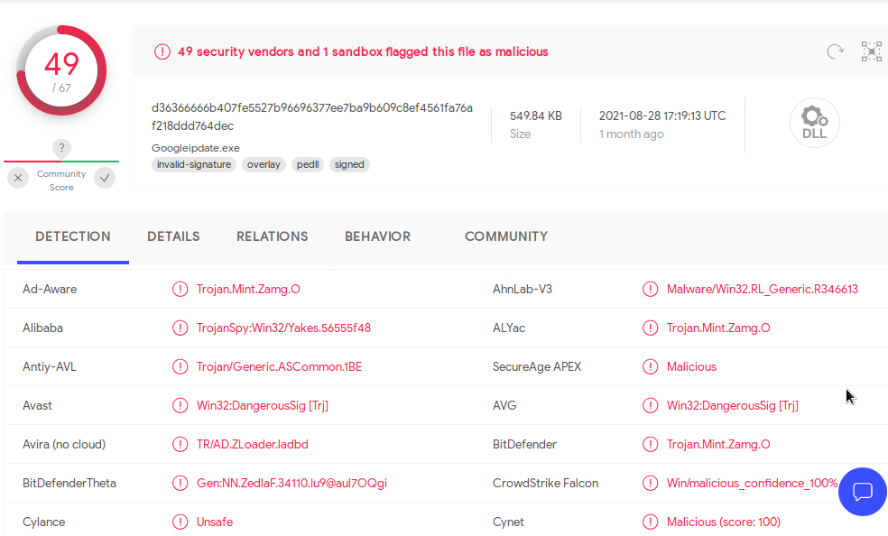
Malicious Activity 2: 205.185.125.104/files/june11.dll
Summarize the following:
What kind of traffic did you observe? Which protocol(s)?
HTTP web traffic
What, specifically, was the user doing? Which site were they browsing? Etc.
User downloaded a file called june11.dll from 205.185.125.104/files/june11.dll. After
The file was found to be a trojan after uploading to VirusTotal.com
Notes:
Kevin Omana

Slide 17

The End
‹#›
Notes:
Benny Mosley

